Slide 1

Speech Emotion Recognition
December - 2023

Slide 2


Agenda
Introduction
Project objective
Literature Review
Project Flow
Feature Extraction
Data Augmentation
Data Preparation
Model Building
Conclusion
Future Plan
Application
References

Slide 3

Introduction
In our daily lives, emotions play a pivotal role in communication.
Conventional HCI lacks the ability to comprehend and respond to the emotional nuances embedded in spoken language, presenting a formidable challenge in creating truly empathetic and user-friendly interfaces.
Communication is more than words; it's a rich tapestry woven with emotions.
In HCI, acknowledging emotional nuances becomes a game-changer.
Harnessing this power unlocks possibilities in accessibility, personalization, and beyond.

Slide 4

Objective
The primary objective of this project is to develop an advanced Speech Emotion Recognition (SER) system tailored for enhancing Human-Computer Interaction (HCI).
The project aims to create a robust and efficient model capable of accurately detecting and interpreting emotional cues within spoken language, thus enabling a more intuitive and responsive interaction between humans and computers.

Slide 5
Literature Review
The Paper "DeepEMO: A Deep Learning Approach for Speech Emotion Recognition," introduces a novel methodology for addressing the challenge of recognizing emotions in speech using deep learning techniques.
The paper begins by emphasizing the importance of emotional intelligence in decision-making.
Two main pipelines: preprocessing for feature extraction and a deep learning CNN model for training and recognition.
Steps include fast Fourier transform (FFT), mel scale generation, and spectrogram generation for melspectrogram audio feature extraction.
Data preprocessing techniques like standard scaler, normalization are performed to improve convergence of algorithm.
Notable results include achieving 99.9% accuracy on validation with multiple variation.

Slide 6
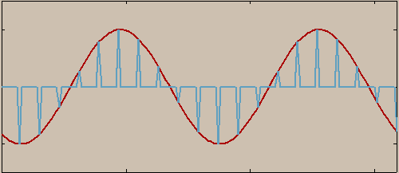
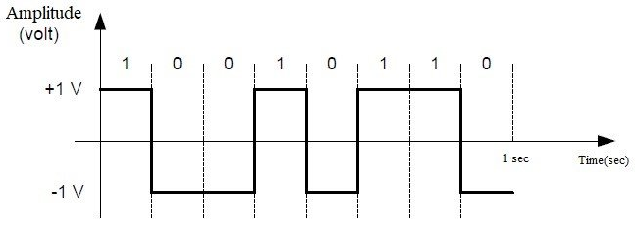
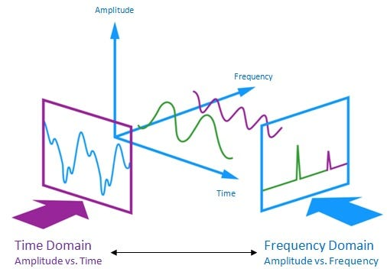

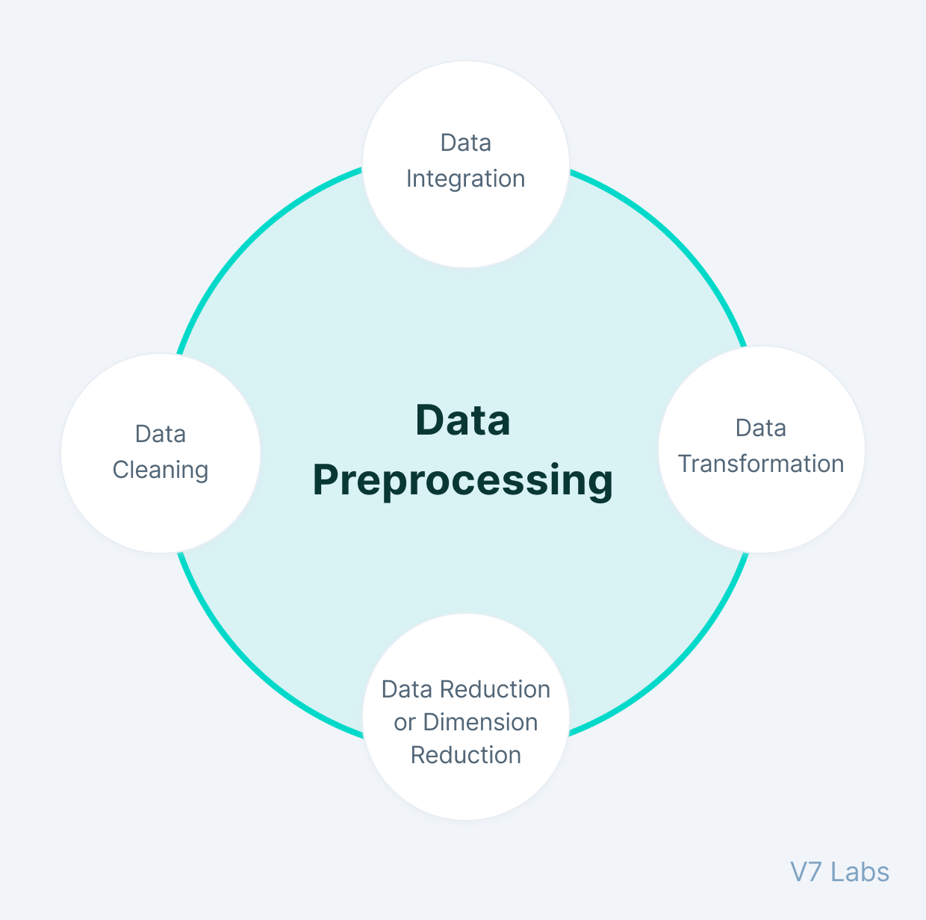
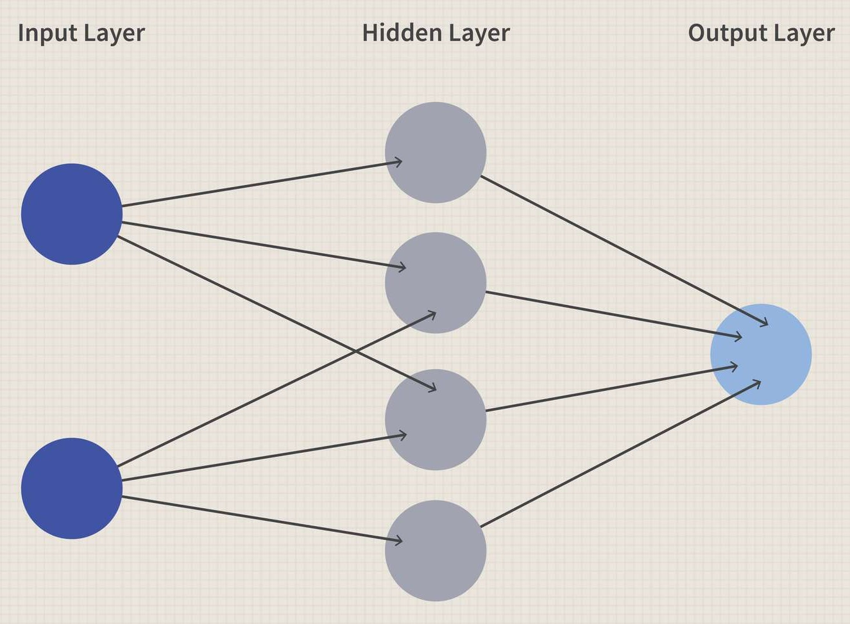

Project Flow
Analog Signal
Feature Extraction
Digital Signal
Audio
Classification
CNN Model

Slide 7
Analog to Digital
Analog-to-Digital Conversion (ADC) is a fundamental process.
The conversion in python can be done using library Librosa.
The audio file should be in WAV format. Which represent amplitude of the audio signal at different points in time.
Librosa reads the audio file and loads it into memory. The result is Numpy array containing samples and sampling rate.
The sampling rate is the number of samples of a continuous signal taken per second during the process of analog-to-digital conversion.
Now we have our digital signal and librosa help us to extract features and visualize this signal in time and frequency domain.

Slide 8
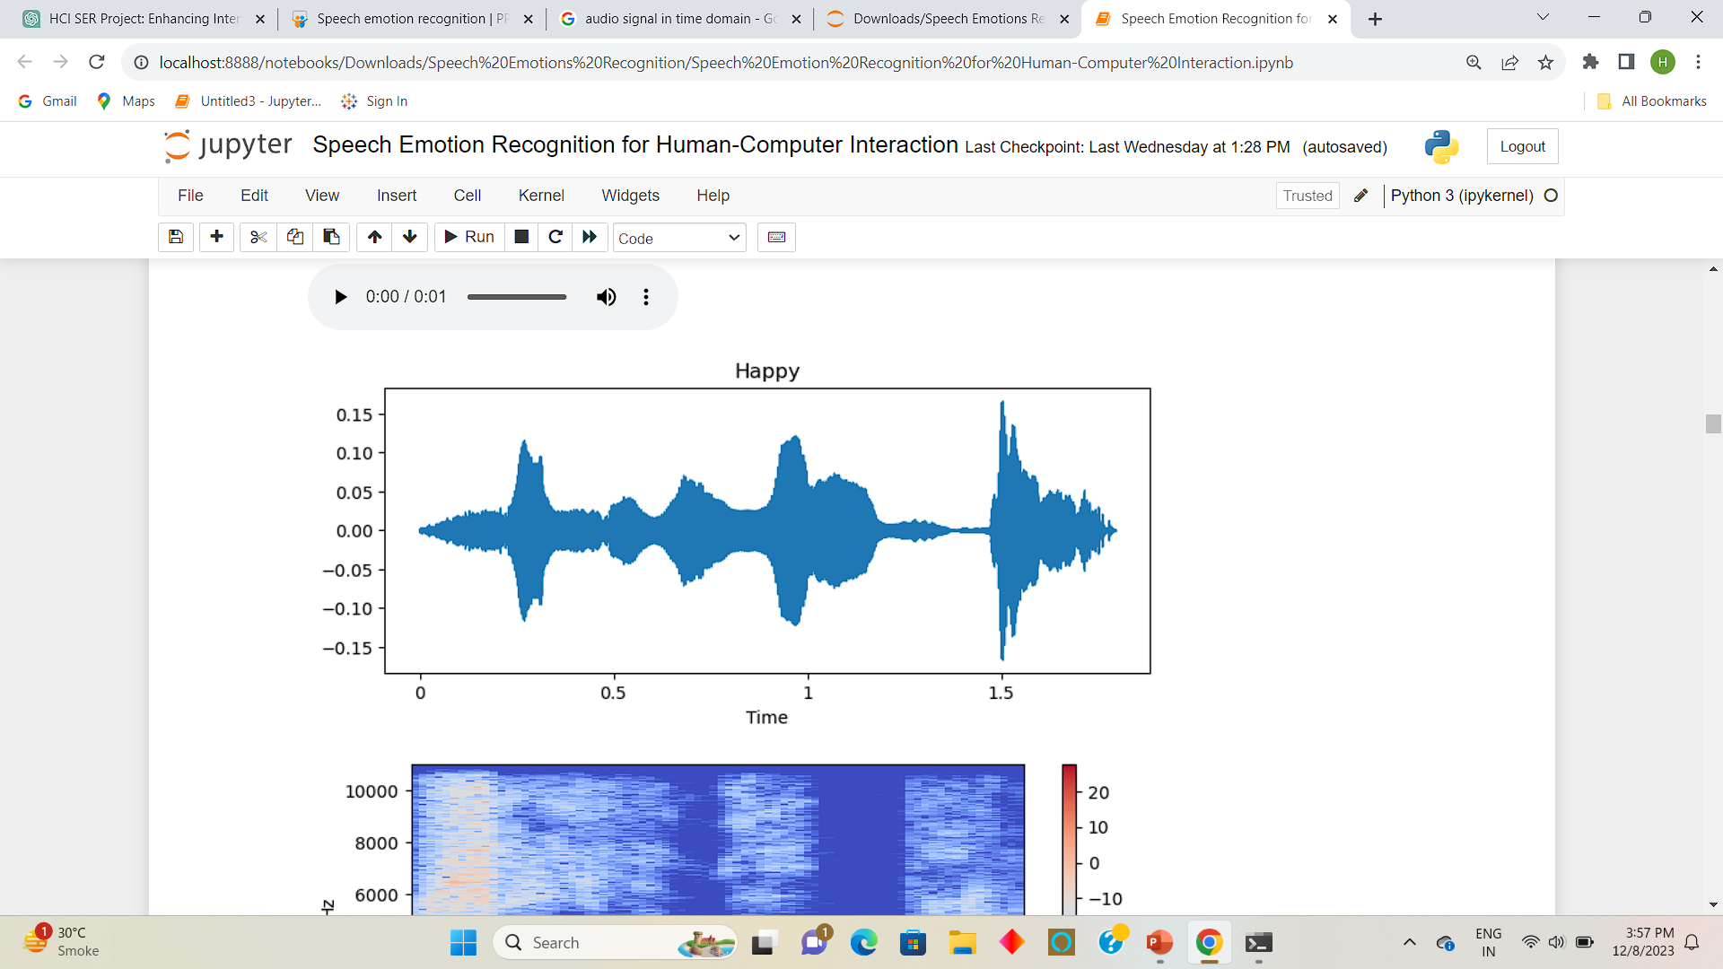
Time Domain
Time domain involves examining the amplitude variations of the signal over time.
From time domain we can extract and analyze key feature like Root mean square, Zero Crossing rate etc.
RMS provides a measure of the overall intensity or loudness of the signal by taking square root of the mean of the square value of the signal amplitude.
It measures the rate at which a signal changes its sign, crossing the zero amplitude axis. In the context of speech and audio signals, Zero Crossing Rate provides information about the frequency of changes in the waveform.

Slide 9
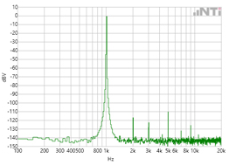
Frequency Domain
The frequency domain involves examining the distribution of frequencies within the signal.
From time domain we can extract and analyze key feature like Short time feature transform, Mel frequency cepstral coefficient etc.
The STFT breaks the signal into short overlapping segments and provides a 2D representation of frequency content over time.
MFCCs capture the spectral characteristics of a signal. The Mel scale is a perceptual scale of pitches that approximates the human ear's response to different frequencies.

Slide 10
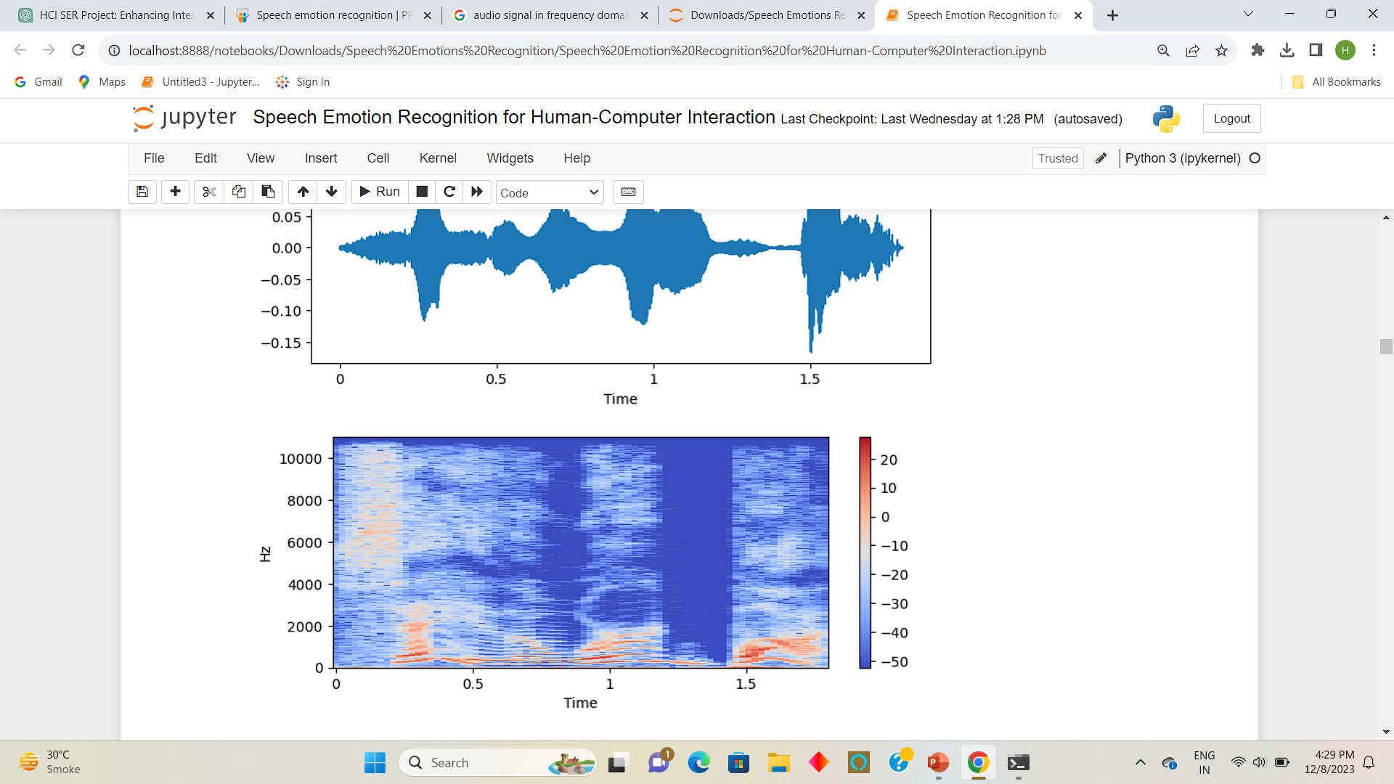
Frequency Domain
The computation of MFCCs involves several steps:
Framing Length
Apply window function
Compute STFT
Apply Mel filter bank
Take log of filter bank
Apply Discrete Cosine Transform
Extract MFCC

Slide 11
Data Augmentation
Data augmentation is a common technique in audio processing to artificially increase the size of a dataset.
This helps improve the robustness and generalization of machine learning models.
The data augmentation techniques like adding noise, time shifting, pitch shifting, and time stretching can be performed in Python using the librosa library.
In project following techniques are used:
Noise: Adds Gaussian noise to the audio waveform.
Time shift: Shifts the audio in time by a random amount.
Pitch shift: Changes the pitch of the audio by a specified factor.
Time Stretch: Stretches or compresses the time of the audio.

Slide 12
Data Preparation
Null Value Treatment
Batch Normalization
Train Test Split
Standard Scaler
One-Hot Encoding

Slide 13
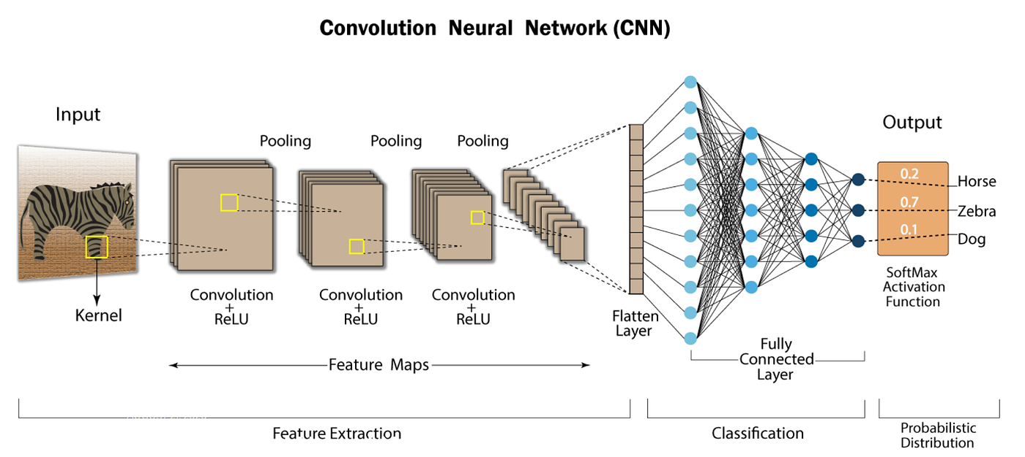
Model Building

Slide 14
Why CNN?
Spectrograms are 2D visual representations of the spectrum of frequencies in a sound signal over time. CNNs are well-suited for processing grid-like data and can effectively capture spatial patterns in spectrograms.
CNNs excel at capturing local features through their use of convolutional filters. In the context of speech emotion, local acoustic features or patterns may be crucial for distinguishing between different emotional states.
CNNs inherently have translation invariance, meaning they can recognize patterns regardless of their specific location in the input space. In speech emotion recognition, where the exact timing of emotional cues may vary, this property can be advantageous.

Slide 15
Model Architecture
Conv1D layers are used for one-dimensional convolution.
Batch normalization layers follow each convolutional layer.
Batch normalization helps stabilize and accelerate the training process by normalizing the input.
MaxPooling1D layers are applied for down-sampling.
Flatten layer is used to convert the 3D output to a 1D array before feeding into the fully connected layers.
Dense layers serve for classification. The first dense layer has 512 neurons and uses Rectified Linear Unit (ReLU) activation. The second dense layer outputs 6 neurons, matching the number of classes in your classification task.
The model has a total of 8,437,894 parameters.
Trainable parameters are 8,433,542, while 4,352 parameters are non-trainable.

Slide 16
Model Fitting
Utilize Adam Optimizer
Adam is an adaptive optimization algorithm, adjusting learning rates for efficient convergence.
Early Stopping Implementation
Early stopping prevents overfitting by halting training when the model's performance on the validation set degrades.
Learning Rate Reduction at Plateau.
Dynamically adjusts learning rates to optimize convergence, especially on plateaus in the loss landscape.
Epoch Configuration: 50 Epochs
Each epoch represents a complete pass through the training dataset.

Slide 17
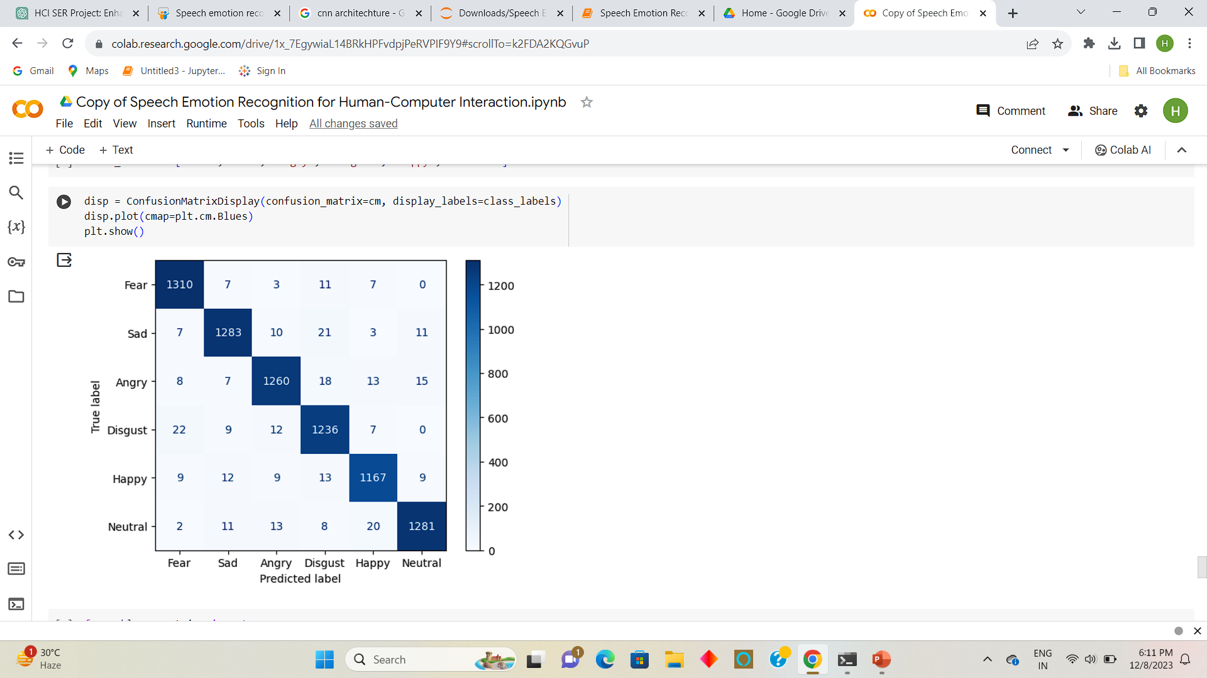
Conclusion
Achieving an outstanding accuracy of 99% on the training dataset.
Equally promising is the model's consistent accuracy of 96% on the testing dataset.
The overall structure of the confusion matrix suggests that the model has demonstrated proficiency in distinguishing between different emotions.
The remarkable performance of our Convolutional Neural Network (CNN) model extends beyond its training dataset, demonstrating a notable ability to generalize well to unseen data.

Slide 18



Application
Voice Assistance
Marketing Strategy
Suicide Prevention

Slide 19
Future Plan
Emotion Detection:
Implement module for emotion analysis using ML or NLP on user input (voice, text, facial expressions).
Playlist Mapping:
Map detected emotions to predefined emotional categories for music (e.g., happy, sad, energetic).
Recommendation Engine:
Develop a music recommendation engine using collaborative or content-based filtering for emotion-based song suggestions.
Integration with Music Platforms:
Integrate with popular music services or local libraries, ensuring seamless compatibility with music platform APIs.
Real-Time Playlist Updates:
Dynamically update playlists in real-time as user emotions change, creating a personalized and evolving music experience.

Slide 20
References
DeepEMO: Deep Learning for Speech Emotion Recognition https://arxiv.org/pdf/2109.04081.pdf
Speech Emotion Recognition Using Machine Learning Dr. C sunitha ram [1] , B. Varshini [2], B. Varsha [3] https://www.ijcstjournal.org/volume-10/issue-1/IJCST-V10I1P11.pdf
Librosa Documentation https://librosa.org/doc/latest/index.html
Kaggle https://www.kaggle.com/datasets/dmitrybabko/speech-emotion-recognition-en
TensorFlow Documentation https://www.tensorflow.org/api_docs
Keras Documentation https://www.tensorflow.org/guide/keras

